Slide 1
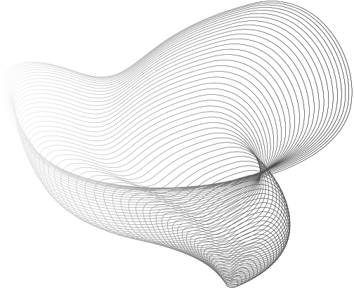


JAYAKODY J.A.A.U.
200242V
Understanding DICOM
How to read, write and organize medical images

Slide 2

Medical Imaging Formats
DICOM (Digital Imaging and Communications in Medicine) - The most widely used standard for storing, transmitting, and exchanging medical images and related information.
NRRD (Nearly Raw Raster Data) - A flexible file format for storing n-dimensional raster data
NIfTI (Neuroimaging Informatics Technology Initiative) - A file format commonly used in neuroimaging for storing MRI, fMRI, and other brain imaging data.
TIFF (Tagged Image File Format) - A general-purpose format used in medical imaging, particularly for storing 2D images like pathology slides.
4

Slide 3
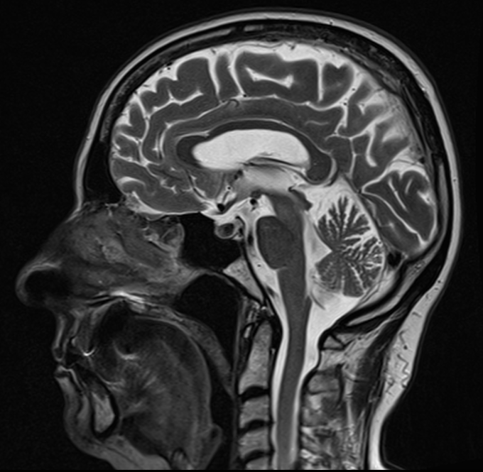
DICOM Images
A digital vault that holds,
Header - Overflowing with patient demographics, modality details, acquisition date and time, and more.
Pixel Data - The core image information is depicted in grayscale or color, depending on the format.
Private Tags - Manufacturer-specific details complementing the standardized data.
4

Slide 4
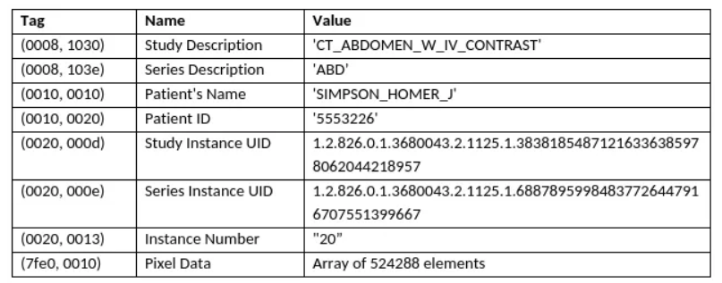
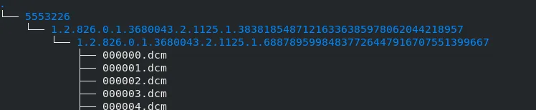
DICOM Header
It consists of all the information
needed to identify the file,
Patient - the person receiving the exam
Study - imaging procedure being performed, date and time, hospital
Series - A series may represent the patient being physically scanned multiple times in one study (typical for MRI), or it may be virtual, where the patient is scanned once and that data is reconstructed in different ways (typical for CT)
Instance - every slice of a 3D image is treated as a separate instance
5

Slide 5
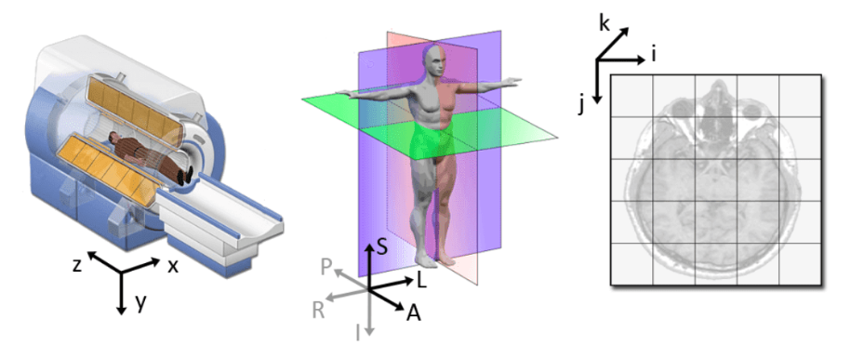
Anatomical Coordinate System
Standard Anatomical Planes,
The Axial Plane
The Sagittal Plane
The Coronal Plane
World
Coordinates
Anatomical
Coordinates
Image
Coordinates
5

Slide 6
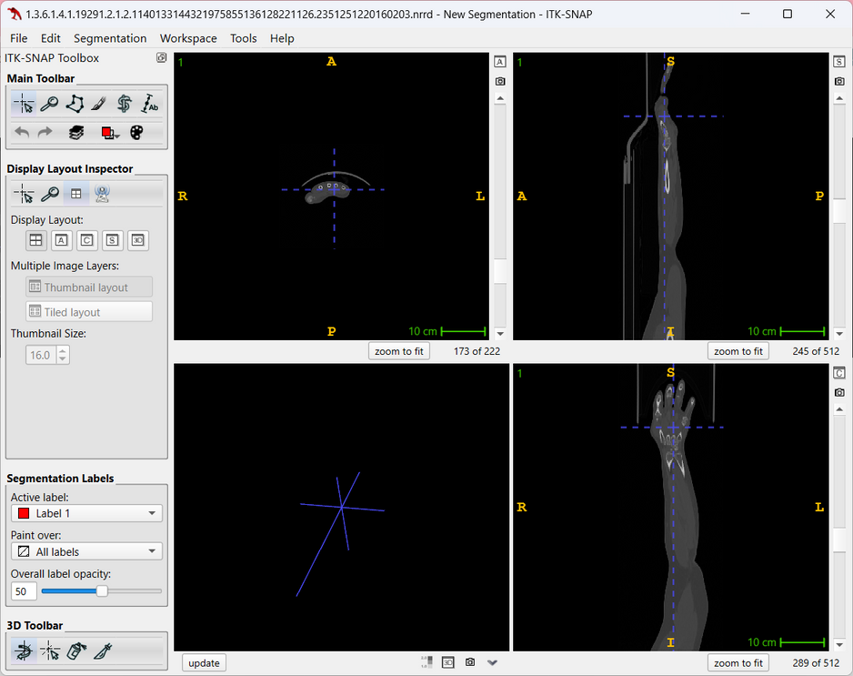
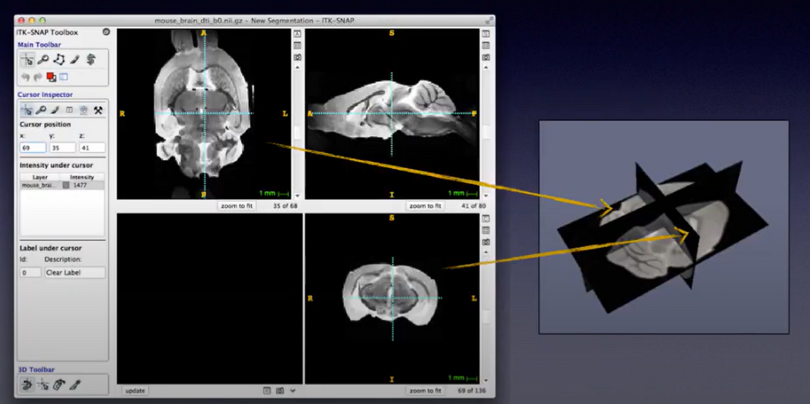
ITK-SNAP
5

Slide 7
Thank You!
5

